Slide 1

Database Security
R.Saravanan Sr.Prof of IT VIT

Slide 2
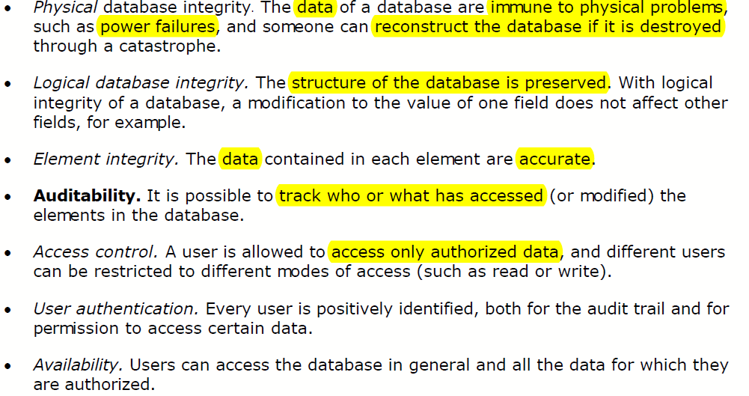
Security requirements of database systems
R.Saravanan Sr.Prof of IT VIT

Slide 3
Security vs Precision
To increase availability of data, disclose as much data as possible
Sensitive data in the database should be protected from disclosure as they are confidential
Precision: aims to protect all sensitive data while revealing as much non-sensitive data as possible
R.Saravanan Sr.Prof of IT VIT

Slide 4
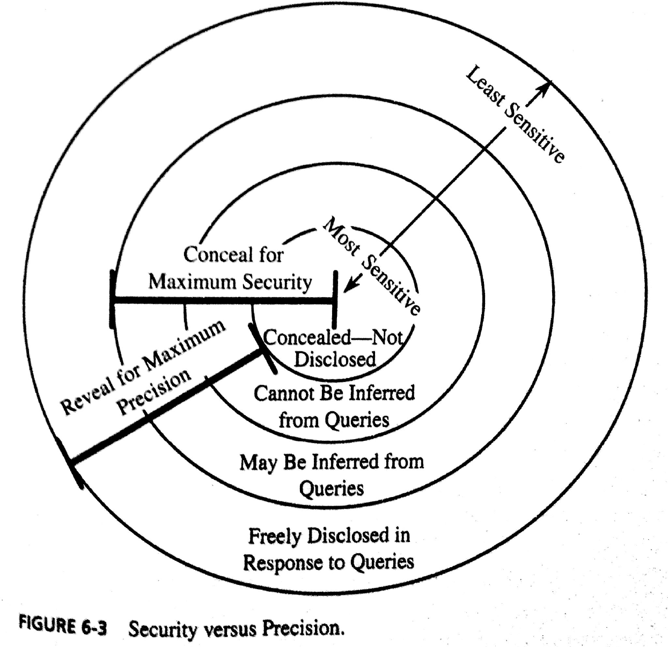
R.Saravanan Sr.Prof of IT VIT

Slide 5
Remark
Rule: “n items over k percent” means that data should be withheld if n items represent over k percent of the result reported.
  i.e., do not reveal results when a small number of people make up a large proportion of a category
So DBMS may conceal data when a small number of entries make up a large proportion of data revealed
R.Saravanan Sr.Prof of IT VIT

Slide 6

Consider the following university students’ database containing fields:
  name, sex, race, financial aid, parking fines, drug use, dormitory.
  Non-sensitive/least sensitive fields are: name, dormitory
  Most sensitive fields: financial aid, parking fines, drug use
  Medium sensitive fields: sex, race
Few people will have access to each of most sensitive fields, but no one will have access to all “most sensitive fields”
R.Saravanan Sr.Prof of IT VIT

Slide 7
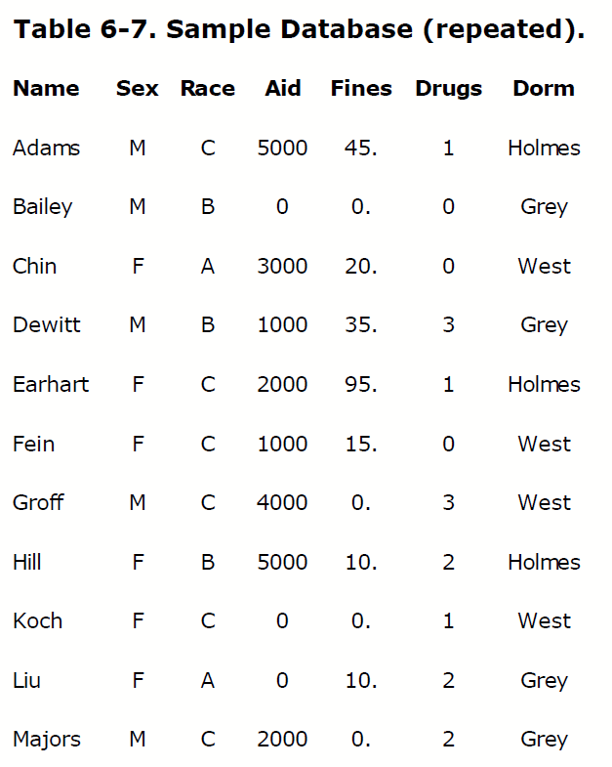
Drugs: 0 means never used
3 means frequent user
R.Saravanan Sr.Prof of IT VIT

Slide 8
Inference Problem
Inference problem is a way to infer or derive sensitive data from non-sensitive data
Inference problem can be solved by
  Direct attack
  Indirect attacks
  Tracker attacks
R.Saravanan Sr.Prof of IT VIT

Slide 9
Direct Attacks
Determine values of sensitive fields by directly writing specific queries to get the data from the database.
Eg., to know male students who use drug rarely, we can write direct query:
  List NAME where SEX=M ^ DRUGS=1
DBMS will not give the result as per rule “n items over k percent”, since query result has 1 record and 1 percent selected has 100 percent of the data reported.
This is obvious attack
R.Saravanan Sr.Prof of IT VIT

Slide 10
The same result can be produced by following less obvious query:
  List NAME where
    (SEX=M ^ DRUGS=1) v
    (SEX≠M ^ SEX≠F) v
    (DORM=AYERS)
    This query does not appear to be specific but achieves same result.
R.Saravanan Sr.Prof of IT VIT

Slide 11
Indirect attack
To protect sensitive data, an organization will publish statistics such as count, sum and mean by suppressing individual names, addresses, or other fields by which single person/individuals can not be identified.
Indirect attack is a statistical attack to infer individual data/sensitive data from one or more intermediate statistical results.
R.Saravanan Sr.Prof of IT VIT

Slide 12
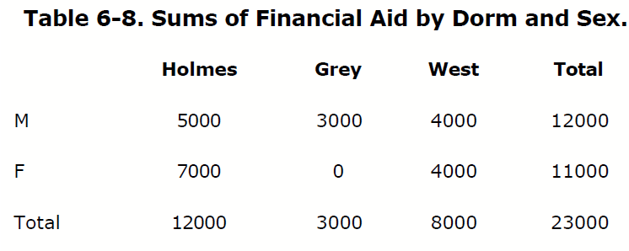
sum
From the following report, we can infer that no female living in Grey receives financial aid. This approach is used to determine negative results
R.Saravanan Sr.Prof of IT VIT

Slide 13
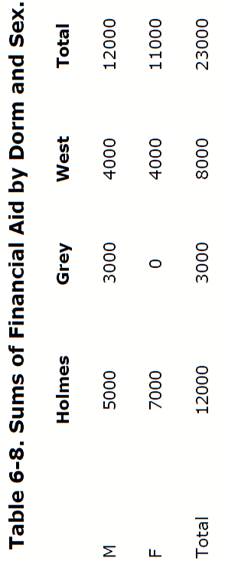
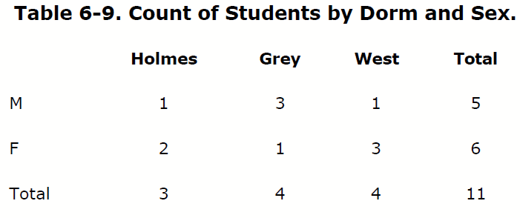
count
By using preceding sum table and following count table, we can infer that
  1 male from Holmes receives aid of 5000
  1 male from West receives aid of 4000
  1 female from Grey receives no aid
  We can obtain Names by selecting subschema NAME, DORM that are not sensitive data :
    Eg List NAME where SEX=M ^ DORM=HOLMES
R.Saravanan Sr.Prof of IT VIT

Slide 14
Tracker Attacks
If there are n values in the database, then Tracker attack will identify unique value by querying n-1 other values.
  Given n and n-1, we can easily identify 1 element by eliminating n-1 from n.
Tracker attack uses additional queries in such a way that two sets of records cancel each other leaving only desired data.
R.Saravanan Sr.Prof of IT VIT

Slide 15
Example
How many female Caucasians live in Holmes?
The sensitive query:
  Count ( ( SEX=F) ^ (RACE=C) ^ (DORM=Holmes) )
  Will fetch one record but it will not be displayed as per “n items over k percent rule”
Note:
  n(a^b^c) = n(a) – n(a ^ ┐(b^c) ) (Venn diagram)
  n(┐(b^c)) = n(┐b v ┐ c)
R.Saravanan Sr.Prof of IT VIT

Slide 16
The same result can be obtained by following non-sensitive equivalent query:
Let a be SEX=F, b be Race=C and
c be DORM=Holmes
Then count (a^b^c)=count(a)-count(a^(not b v not c) )
= 6 – 5
= 1 ( sensitive data)
R.Saravanan Sr.Prof of IT VIT

Slide 17
Multilevel database security
R.Saravanan Sr.Prof of IT VIT

Slide 18
Database security
Database security is provided by following mechanisms:
  Partitioning
  Encryption
  Integrity lock
  Sensitivity lock
R.Saravanan Sr.Prof of IT VIT

Slide 19
partitioning
Database is divided into separate databases based on the sensitivity levels of data
  Eg., Most sensitive data in level 1, so in DB 1
  ………
  Least sensitive data in level n, so in DB n
  Define/restrict access to these databases to various users based on their privileges.
  So partitioning provides security based on access control
R.Saravanan Sr.Prof of IT VIT

Slide 20
encryption
Store the sensitive data in an encrypted form.
  Identify the sensitive data
  classify them into various levels based on sensitivity.
  Create table for each level of data
  Use separate key for each sensitive level to encrypt the data in the table.
R.Saravanan Sr.Prof of IT VIT

Slide 21
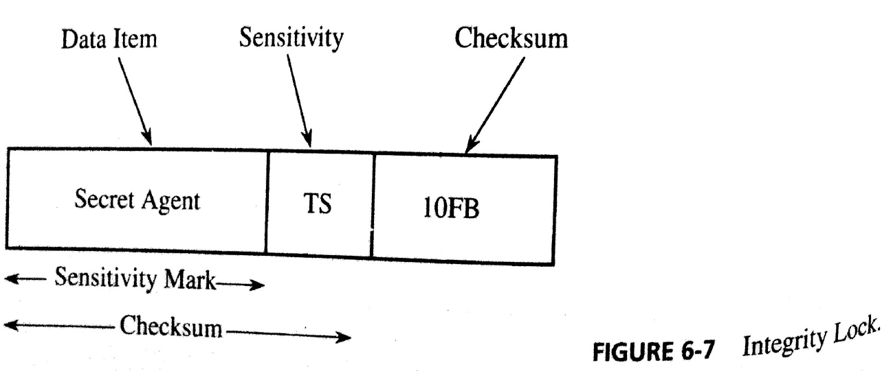
Integrity lock
Lock is created to provide integrity and limited access for a database
Integrity lock has 3 parts: actual data, sensitivity label, and checksum
  Each data can be figuratively painted with a colour that denotes its sensitivity
  Calculate checksum on both data and its sensitivity label
R.Saravanan Sr.Prof of IT VIT

Slide 22
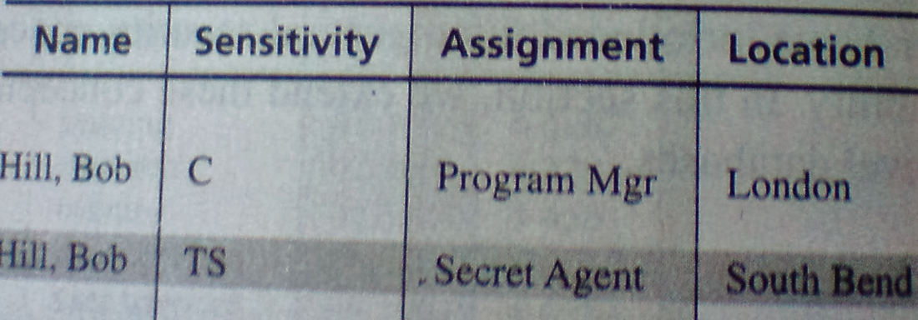
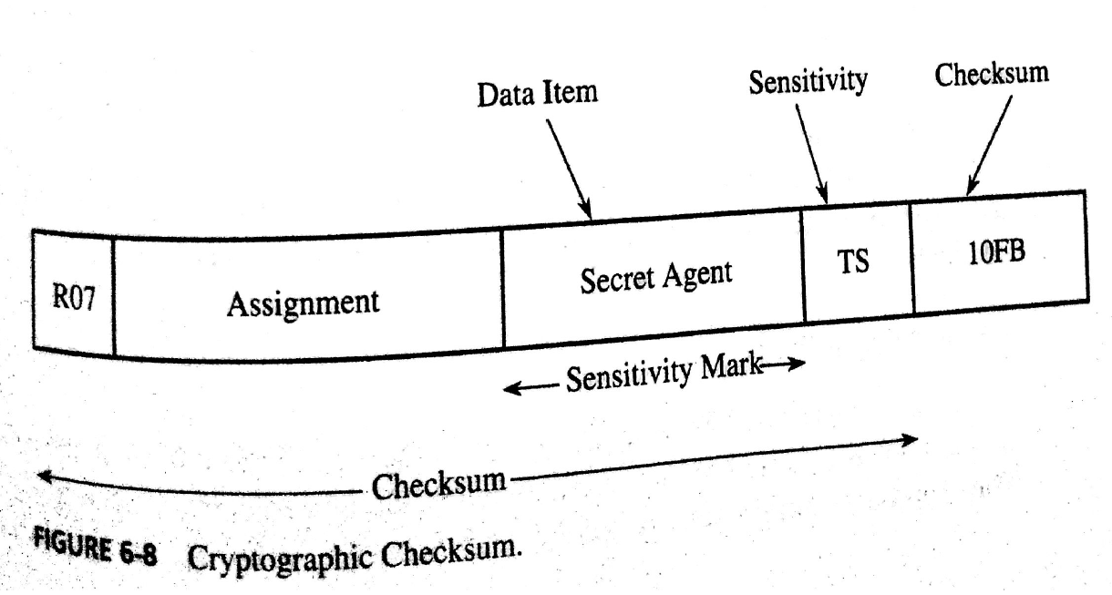
  Sensitivity label must be unique, concealed &unforgeable
Checksum is an error-detecting part generated by cryptographic algorithm(eg., DES), hence it is called as cryptographic checksum.
To get unique checksum value for each element we can calculate the checksum on 4 parts: record number, attribute field name, data, sensitivity label.
R.Saravanan Sr.Prof of IT VIT

Slide 23
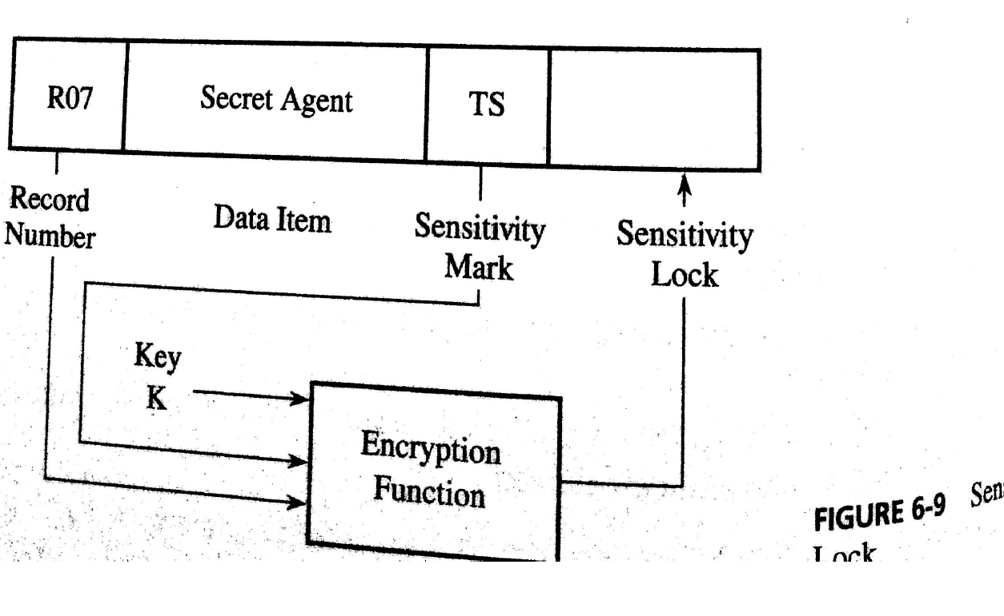
Sensitivity lock
It protects sensitivity level of an element from un-authorised changes by encrypting record no and sensitivity label of the element as shown below:
R.Saravanan Sr.Prof of IT VIT

Slide 24
Design of multilevel secure databases – approaches used are:
  Integrity lock
  Trusted front end
  Commutative filters
  Distributed databases
  Windows / views
R.Saravanan Sr.Prof of IT VIT

Slide 25
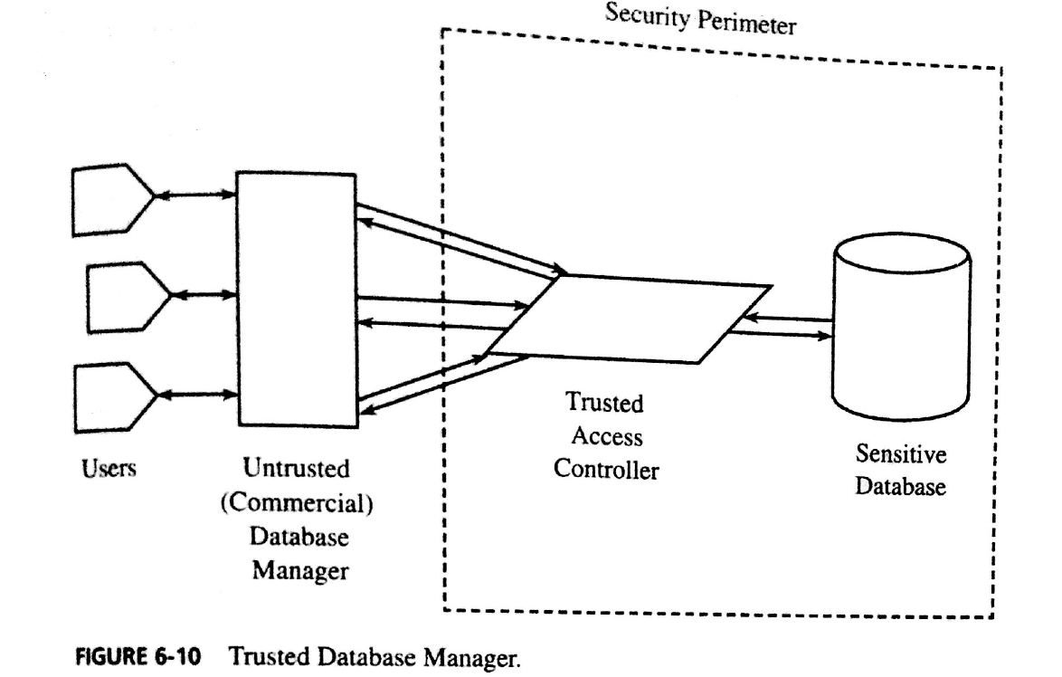
Integrity lock
Uses any (untrusted) database manager with trusted procedure that handles access control as shown in following fig.
Sensitive data with sensitivity label are stored in encrypted form.
R.Saravanan Sr.Prof of IT VIT

Slide 26
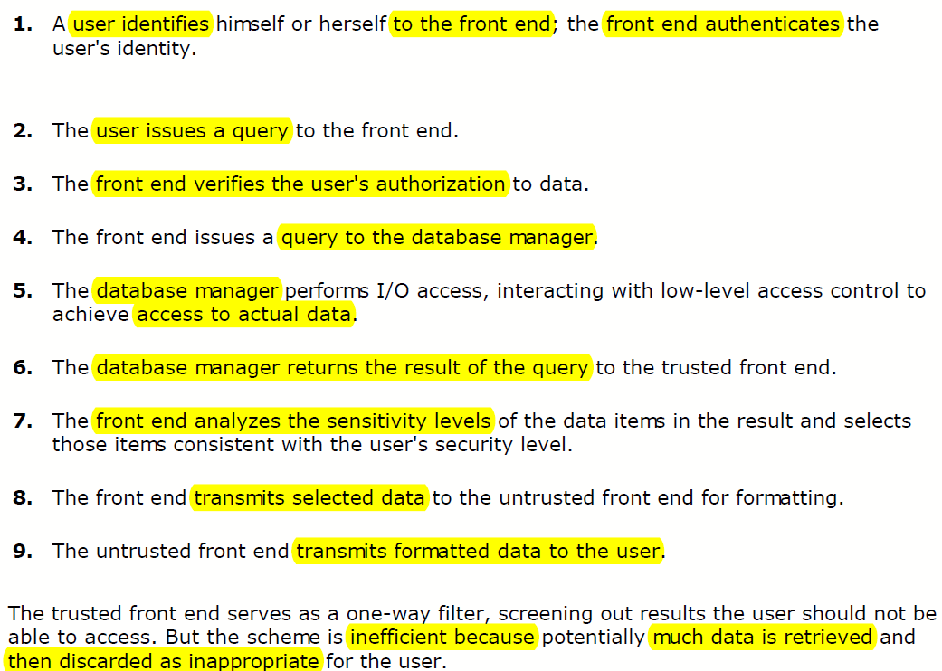
Trusted front end
It uses trusted front that acts as a guard between users and DBMS. Steps involved are:
R.Saravanan Sr.Prof of IT VIT

Slide 27
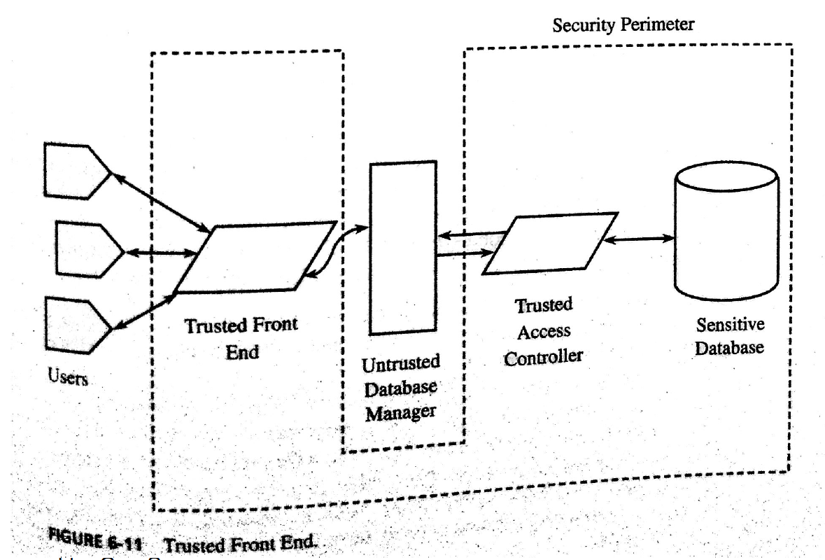
R.Saravanan Sr.Prof of IT VIT

Slide 28
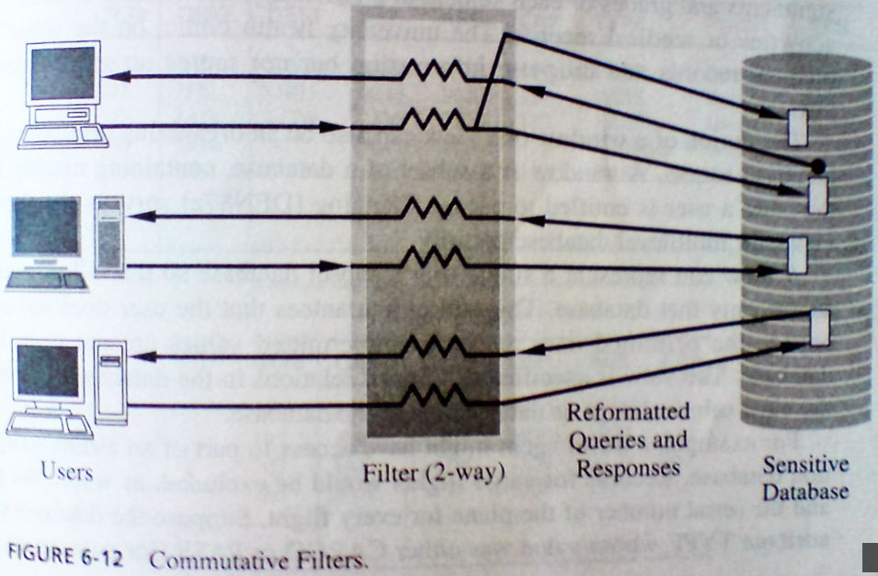
Commutative filters
Filter is an interface between user and DBMS.
It screens user’s query and reformats it, so that only data with permitted sensitivity level are returned to user.
Query reformatting helps the database manager to fetch only the permitted data which is again screened by filter and then passed to user
R.Saravanan Sr.Prof of IT VIT

Slide 29
Example.
Suppose a group of physicists in Washington works on sensitive project and current user is not allowed to access the names of physicists in the db.
If the user’s query is
  List NAME where ( (OCCUP=PHYSICIST) ^ (CITY=WASHDC) )
Then filter reformats the query: (So that sensitive data is not extracted)
  List NAME where ( (OCCUP=PHYSICIST) ^ (CITY=WASHDC) ) from all records R where
  (NAME-SECRECY-LEVEL(R) <= USER-SECRECY-LEVEL)^
  (OCCUP-SECRECY-LEVEL(R) <= USER-SECRECY-LEVEL)^
  (CITY-SECRECY-LEVEL(R) <= USER-SECRECY-LEVEL)

